Slide 1

IE 6200 Project
Group members: aruba alam syed & Nitesh gupta

Slide 2
Problem Statement
Data collection & Variables
Data Analysis & Conclusion
Learnings

Slide 3

Problem Statement

Slide 4
Problem Statement
With the COVID-19 pandemic, enforced lockdowns and social distancing measures; levels of physical activity are expected to have decreased and screen time is expected to have increased.
In this project we want to analyze how these two factors affect stress levels among college students and do other factors like study load, working hours, mode of study and student status have a significant impact on stress.
Do levels of physical activity and screen time affect the stress levels of college students?

Slide 5

Data Collection & Variables

Slide 6
Data Collection
The data for this project was collected using a survey designed and shared via Google Forms.
The form was shared with potential respondents via email and social media (LinkedIn/ WhatsApp/Facebook).
207 people responded to the survey.

Slide 7
Variables
The following variables were included in the analysis:
Age: Age of respondents
Credit Hours: Credit hours taken this semester
Studying Time: Average number of hours spent studying each week
Working Hours: Average number of hours spent working each week
Physical Act Hours: Average number of hours spent on physical activity each week
Screen Time Hours: Average number of screen time hours each week
Level of Study: Level of current study (Undergraduate, Graduate, Post-Graduate, Other)
Mode of Study: Mode of study this semester (In-person, Hybrid, Online (synchronous), Online (asynchronous))
Stress: Stress experienced by the respondent (Scale: 1= Very low, 5= Very High) Calculated as the mean of stress reported due to academics, future prospects and COVID-19

Slide 8

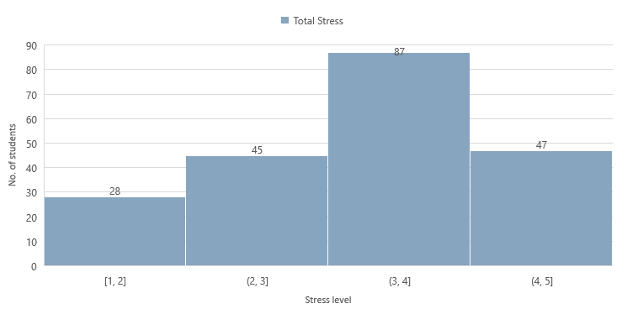
Histogram (Total Stress)

Slide 9
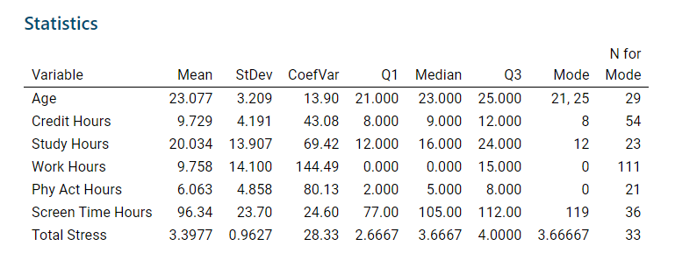
Descriptive Statistics

Slide 10

Data Analysis

Slide 11
Data Analysis
Correlation
Weak negative relationship between Stress and Physical Activity.
Moderate positive relationship between Stress and Screen Time.
No significant relationship between Stress and Working Hours, Credit Hours & Studying Time.
Variable 1 | Variable 2 | Pearson Coefficient
Stress | Physical Activity | -0.309
Stress | Screen Time | 0.509
Stress | Working Hours | 0.120
Stress | Credit Hours | -0.070
Stress | Studying Time | 0.003

Slide 12
Data Analysis
What is regression?
Regression is a statistical method that is used to determine the relationship between a dependent variable and one or more independent variables
The independent variables can be continuous or discrete
Regression analysis through a series of tests and values (p-value and t-values for coefficients!) can be used to determine the nature and strength of the relationship between a dependent and independent variable
Regression Model
Y = a + bX₁ + cX₂ + dX₃ + ϵ

Slide 13
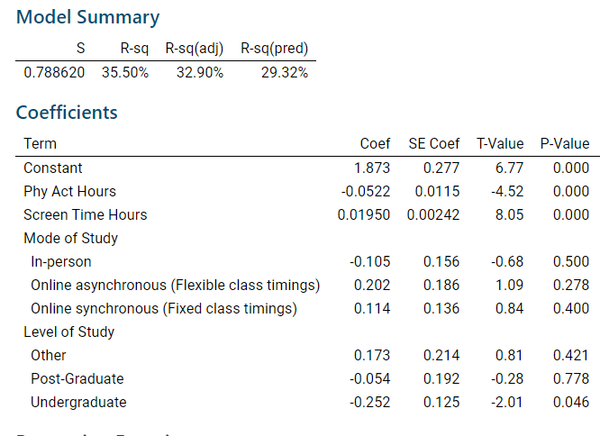
Data Analysis
Regression Analysis
In this model, we have used multiple regression to explain how stress levels among college students are impacted by total screen time, time spent in physical activity, mode of study and student status.

Slide 14
Data Analysis
What is ANOVA?
ANOVA stands for analysis of variance, a statistical test used to determine whether there are any statistically significant differences between the means of three or more independent groups
Response variable: Continuous
Predictor: Categorical factor
Pre-requisites:
Each observation should be independent
It is assumed that the groups have equal standard deviations
Sample data should be from a normal population or n > 15

Slide 15
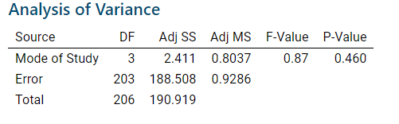
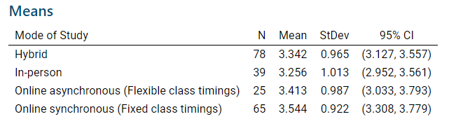
Data Analysis
ANOVA
Test 1: Stress vs. Mode of Study
Null hypothesis: All means are equal
Alternative hypothesis: Not all means are equal
Significance level: α = 0.05
P-value > α: We fail to reject the null hypothesis; the differences between the means are not statistically significant

Slide 16
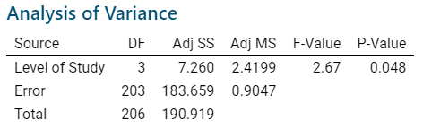
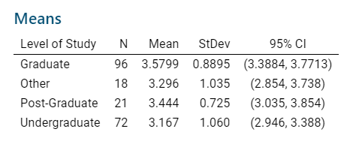
Data Analysis
ANOVA
Test 2: Stress vs. Level of Study
Null hypothesis: All means are equal
Alternative hypothesis: Not all means are equal
Significance level: α = 0.05
P-value <= α: We reject the null hypothesis; the differences between some of the means are statistically significant

Slide 17
The total stress level for students studying online Vs. students who are studying hybrid or in-person
Data Analysis
Z-Test: Two Sample test for mean

Slide 18

Learnings

Slide 19
Learnings
Small sample size; a larger sample size can give more insight
Biasness of respondents: Respondents can be biased while responding depending on various factors, self reporting can also impact data
Simplicity of available responses: The stress variable could be spread on a larger scale to give more sensitivity
Various other factors affect stress like personal relationships, financial situation, existence of a close personal network, and health conditions etc.

